Slide 1


CYBER COURT
AI-BASED CYBERCRIME INVESTIGATION
Presented By:
Osama Ibrahim Mohammad Abughalieh
Akram Ahmad Mohammad Khraiwesh
Raghad Loai Ismail Shalabi
Supervisor: Dr. Mohammed Almaiah

Slide 2
Background and Motivation
Growth of Cybercrime Landscape
The rapid rise of cybercrime, especially phishing and financial fraud, has introduced new investigative challenges in modern digital environments.
These crimes rely heavily on deception, social engineering, and cross-border digital infrastructure, making them difficult to analyze using traditional methods.
Cybercrime investigations require handling complex technical evidence while also understanding legal implications.
However, in many cases, cybersecurity analysis and legal interpretation remain disconnected, creating a critical gap that slows investigations and affects clarity in legal decision-making.

Slide 3
Problem Statement
Fragmented Digital Evidence
Manual Workload
Cybercrime evidence is scattered across emails, links, and financial records...etc, making analysis difficult and time-consuming.
Investigations rely heavily on manual processes, increasing effort, delays, and the risk of errors.
Technical–Legal Gap
Case Complexity
Technical findings are often disconnected from legal interpretation, weakening case clarity.
Complex cyber incidents are difficult to explain clearly to legal stakeholders.

Slide 4
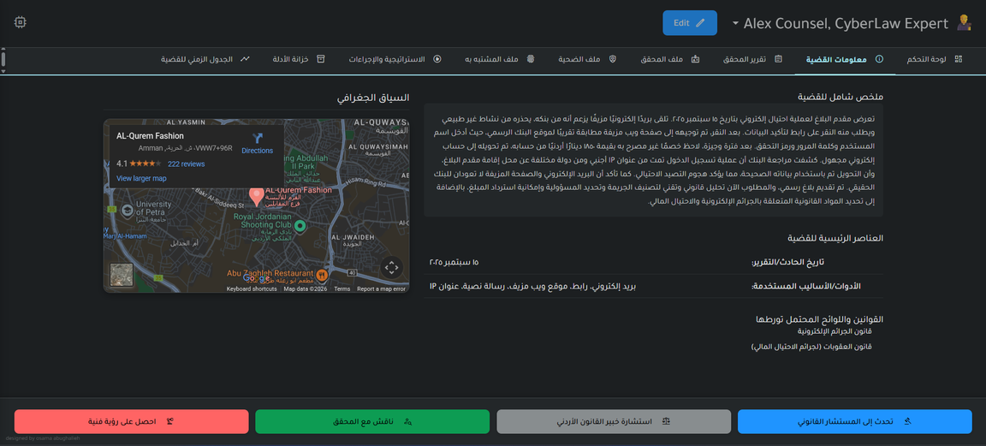
Project Overview
Cyber Court System
Cyber Court is an AI-assisted, web-based system for analyzing cybercrime cases from both technical and legal perspectives.
It focuses on phishing and financial fraud and organizes digital evidence in a clear structure.
System Purpose
The system supports users in understanding cybercrime incidents by linking technical findings with legal context.
It is designed as a decision-support and educational platform.

Slide 5
Project Objectives
Clear Case Organization
Legal Context Mapping
Provide a structured way to manage cybercrime cases and related information.
Link technical cyber findings to relevant legal concepts and cybercrime laws.
Evidence Management
Case Visualization
Organize digital evidence such as emails, URLs, and transaction data in one place.
Present cases using timelines and summarized views for clarity.
AI-Assisted Analysis
Support case understanding through AI-based text analysis and event correlation.

Slide 6
System Scope
Defining the capabilities of Cyber Court System
Included Features
• Phishing attacks
• Financial fraud cases
• Emails and malicious URLs
• Digital identities
• Transaction records
Cyber Court supports the analysis of common cyber threats and online fraud incidents by organizing digital evidence and case information within a defined scope.
Excluded Features
• Real-time monitoring
• Live system integrations
• Automated legal decisions

Slide 7
System Features
Case Management
Create and manage structured cybercrime cases with clear status and summaries.
Evidence Management
Upload, organize, and review digital evidence such as emails, URLs, and transaction records.
Key components enhancing investigation and analysis capabilities
User Profiles
Manage investigator, analyst, and case-related profiles to reflect realistic workflows.
AI-Assisted Analysis
Analyze case descriptions and evidence using AI to extract key information and events.
Legal Advisory
Link technical findings to relevant cybercrime laws and legal explanations.

Slide 8
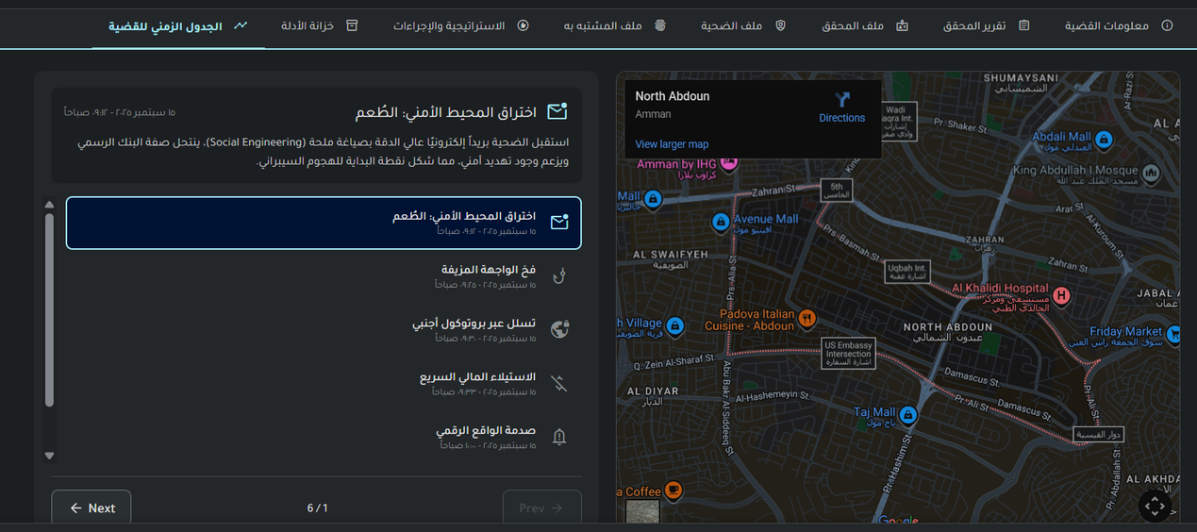
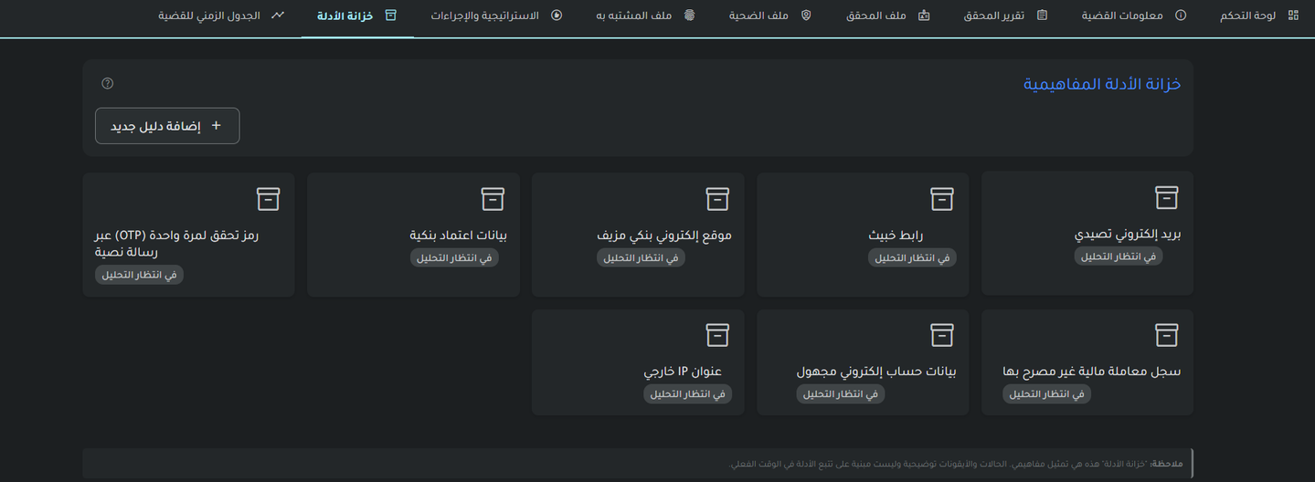

Slide 9
AI Component Overview
Cyber Court uses AI techniques to support case analysis and improve understanding without replacing human judgment.
Text Analysis
Event Correlation
Analyze case descriptions and phishing-related content to identify important details.
Connect extracted information to form a clear sequence of events for each case.
Entity Extraction
Decision Support
Extract key entities such as dates, URLs, account identifiers, and transaction amounts.
Provide explainable insights that help users understand cases rather than make automatic decisions.

Slide 10
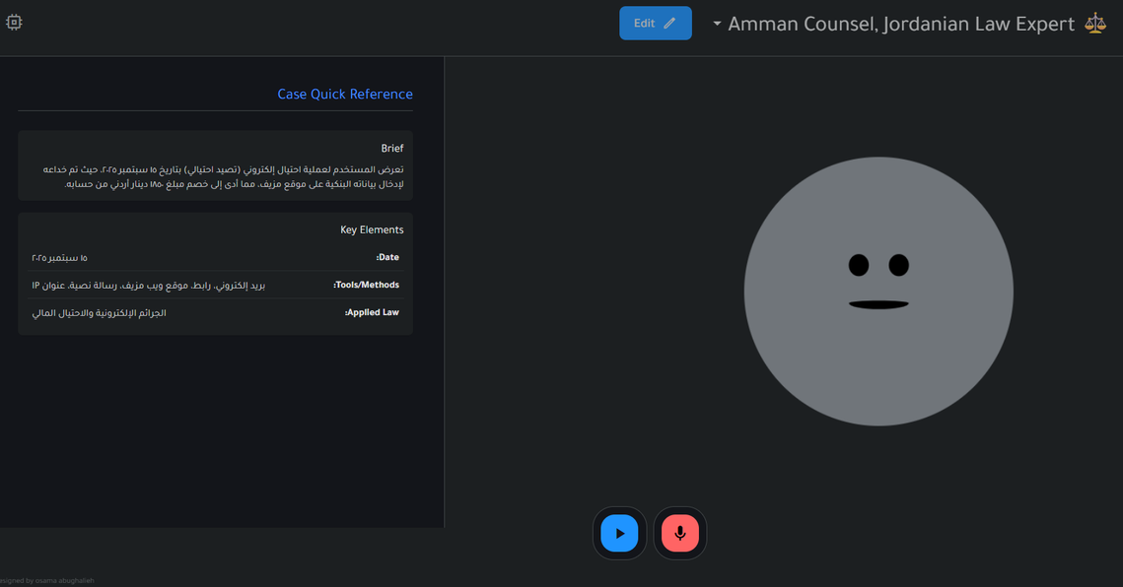
Legal Advisory Module
Cyber Court includes a legal advisory layer to help users understand the legal relevance of cybercrime cases.
Legal Mapping
Link technical cyber findings, such as phishing activities and fraud indicators, to relevant cybercrime laws.
Clear Legal Explanation
Present legal concepts in a simplified and understandable way for non-legal users.
Supportive Role
Assist analysis and learning without providing automated or binding legal decisions.

Slide 11
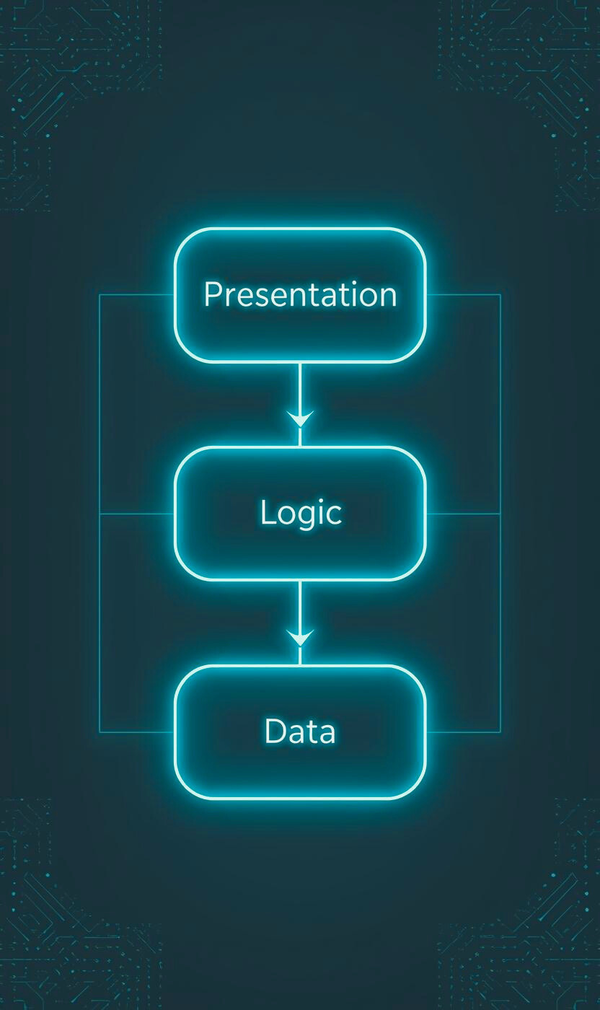
System Architecture
Cyber Court is built using a modular architecture to ensure clarity, maintainability, and future scalability.
Presentation Layer
Web-based user interface that allows users to interact with cases, evidence, and analysis results.
Application Layer
Backend logic implemented using Flask, including case management, AI processing, and legal mapping.
Data Layer
SQL-based database used to store case data, evidence metadata, user information, and legal references.

Slide 12
Technologies Used
Python
Used as the main backend language to handle system logic and AI-based analysis.
Flask
A lightweight Python framework used to build the backend architecture and system routes.
Key technologies powering the Cyber Court system
JavaScript
Used to create interactive and dynamic user interfaces within the system.
HTML & CSS
Responsible for structuring and styling the web interface with a clean design.
SQL Database
Used to store structured case data, evidence records, and legal references.
AI & NLP Techniques
Applied to analyze text data and support case understanding.

Slide 13
Testing & Validation Process
Cyber Court was tested to ensure correct functionality, reliability, and clarity of results.
Unit Testing
Core backend logic and system functions were tested individually.
Integration Testing
System components were tested together to ensure smooth data flow and consistency.
Functional Testing
Features such as case management, evidence handling, and legal mapping were tested based on requirements.
Usability Testing
Basic usability testing was conducted to ensure ease of use and clear navigation.
Case Study Validation
The system was validated using a realistic phishing and financial fraud scenario.

Slide 14
Results and Findings
The implementation of Cyber Court demonstrated several positive outcomes during testing and evaluation.
Improved Evidence Organization
Reduced Manual Effort
Clear Case Timelines
Better Legal Understanding
Event timelines helped present cyber incidents in an organized and understandable way.
Digital evidence was clearly structured and easier to track across cases.
AI-assisted analysis reduced the need for extensive manual processing.
Linking technical findings with legal context improved overall case interpretation.

Slide 15
Challenges Faced
During the development of Cyber Court, several challenges were encountered.
Technical and Legal Integration
Data Quality Dependency
Combining cybersecurity analysis with legal interpretation required careful system design.
Analysis accuracy depended heavily on the quality of user input.
AI Explainability
Time and Academic Constraints
Ensuring AI outputs were clear and understandable without being fully automated.
The project was developed within limited time and academic resources.

Slide 16

Future Enhancements
Cyber Court can be extended in several directions to enhance its capabilities and applicability.
Expanded Cybercrime Coverage
Support additional cybercrime types beyond phishing and financial fraud.
Broader Legal Frameworks
Extend legal coverage to include more jurisdictions and regulations.
Advanced AI Techniques
Apply more advanced AI methods to improve analysis accuracy and insights.
Real-Time Data Integration
Integrate live data sources for more dynamic case analysis.

Slide 17
Conclusion
Cyber Court presents a unified approach to understanding cybercrime cases by combining technical analysis with legal context.
Bridging the Gap
The system successfully connects cybersecurity findings with legal interpretation in a clear structure.
Responsible AI Use
AI is applied as a decision-support tool to enhance understanding without replacing human judgment.
Academic Value
Cyber Court demonstrates a practical and well-scoped graduation project with strong interdisciplinary foundations.

Slide 18
The End
Thank You

